Slide 1
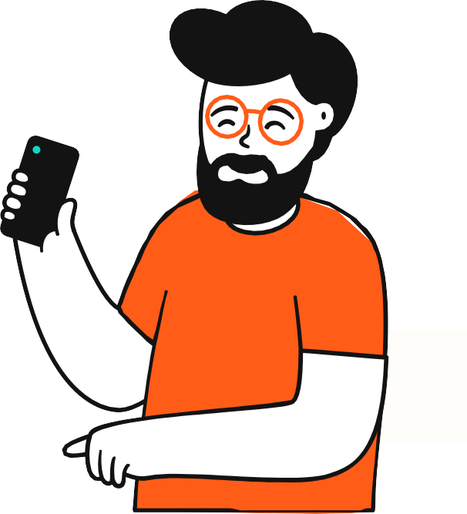



HUMAN-COMPUTER
INTERACTION
Information Technology Department| College of Technologies
Notes:
Interacting with technology has become an essential part of everyday life for the majority of people. The average user of a computer system is now less likely to understand the technology. Since, there are different types of technology they have to use. People are busy and may spend little or no time actually learning a new system.
Therefore, computer systems should be easy to use, easy to learn, and with no errors. To design and develop of such a system is a major concern of HCI. Watch the following video to understand how HCI studies are changing how we interact with everyday devices

Slide 2
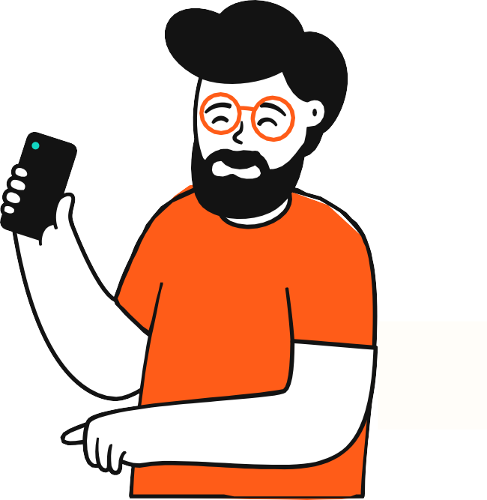

Course Outcome:
Understand the concepts and fundamentals of Human Computer Interaction
Specific Learning Outcomes:
Identify the Human aspect and computer aspect in Human Computer Interaction..
Discuss the interaction concepts between human and computers.

Slide 3

INTRODUCTION

Slide 4
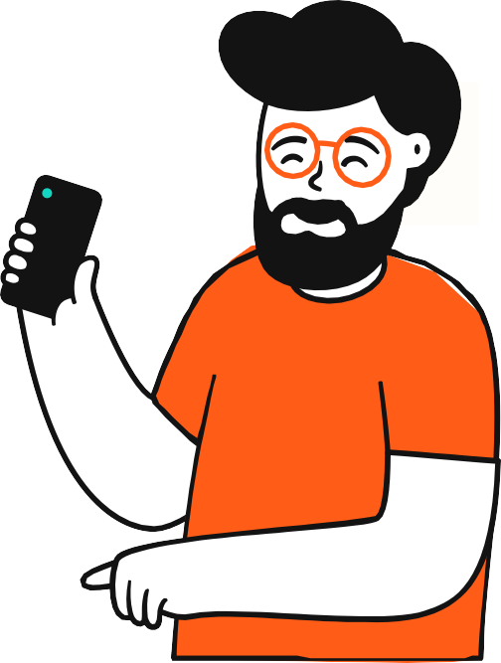
INTRODUCTION
Interacting with technology has become an essential part of everyday life for the majority of people. The average user of a computer system is now less likely to understand the technology. Since, there are different types of technology they have to use.
People are busy and may spend little or no time actually learning a new system.

Slide 5
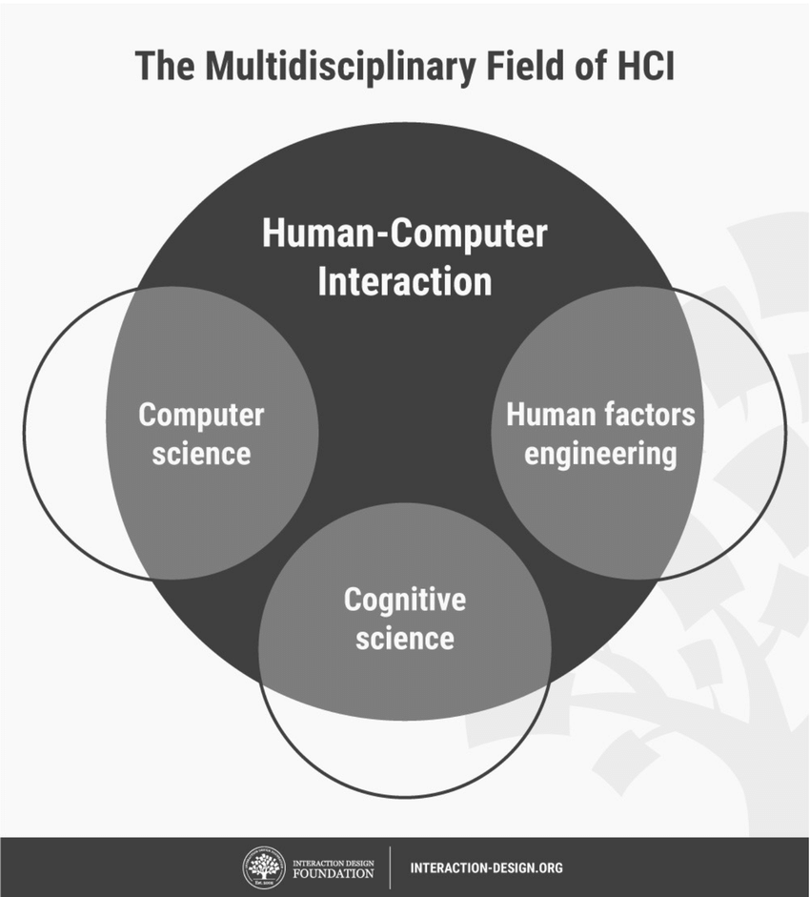
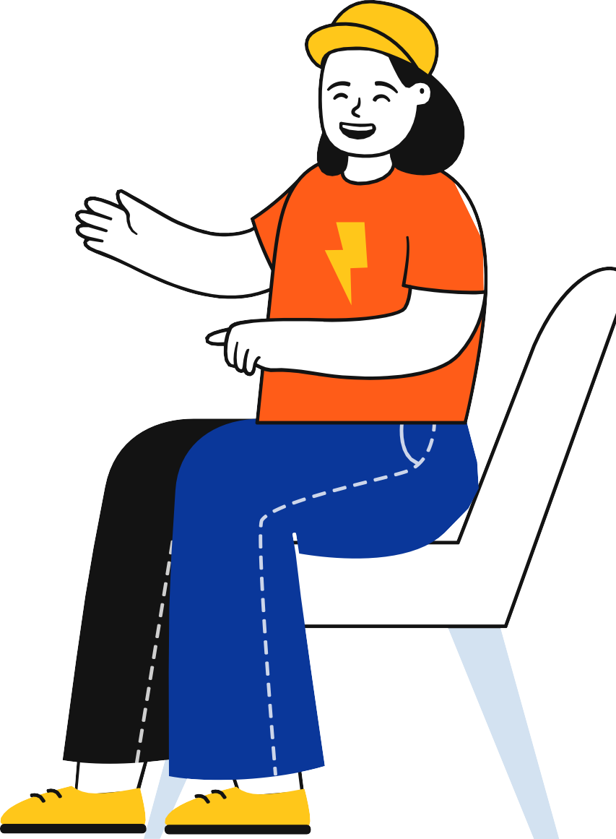
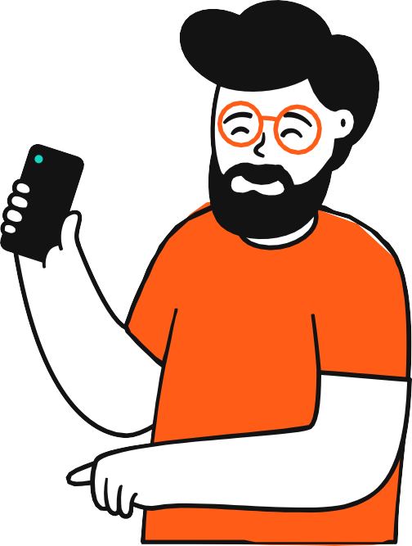

WHAT IS HUMAN-COMPUTER INTERACTION?
It is the study of how the users interact with computer technology.
Human-computer interaction (HCI) is a multidisciplinary field of study focusing on the design of computer technology and the interaction between humans (the users) and computers (www.interactiondesign.org). HCI is also concerned with the physical, psychological and theoretical aspects of the process.
The goal of HCI is to improve the interaction between users and computers by developing Human-centered design with good usability. “if we want to produce a product or services that will be useful and usable, then we must start with an appreciation of the potential users and the types of tasks they will need or want to do.”

Slide 6
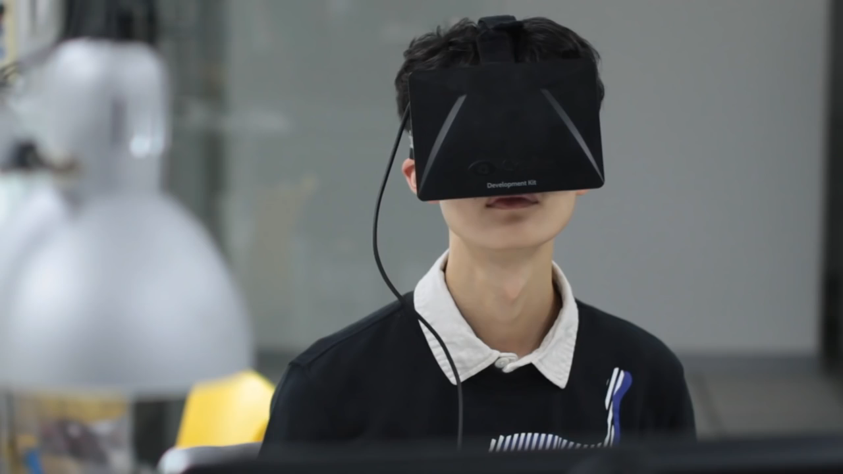
Dexmo: an exoskeleton for you to touch the digital world (PV)

Slide 7
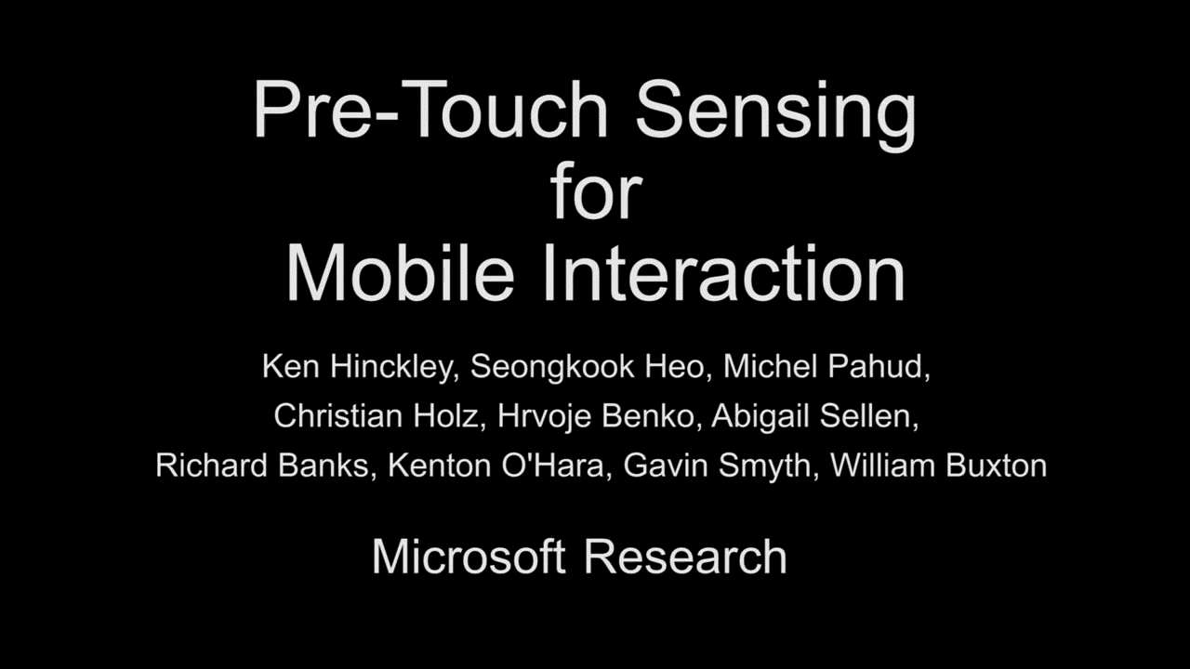
Pre-Touch Sensing for Mobile Interaction

Slide 8
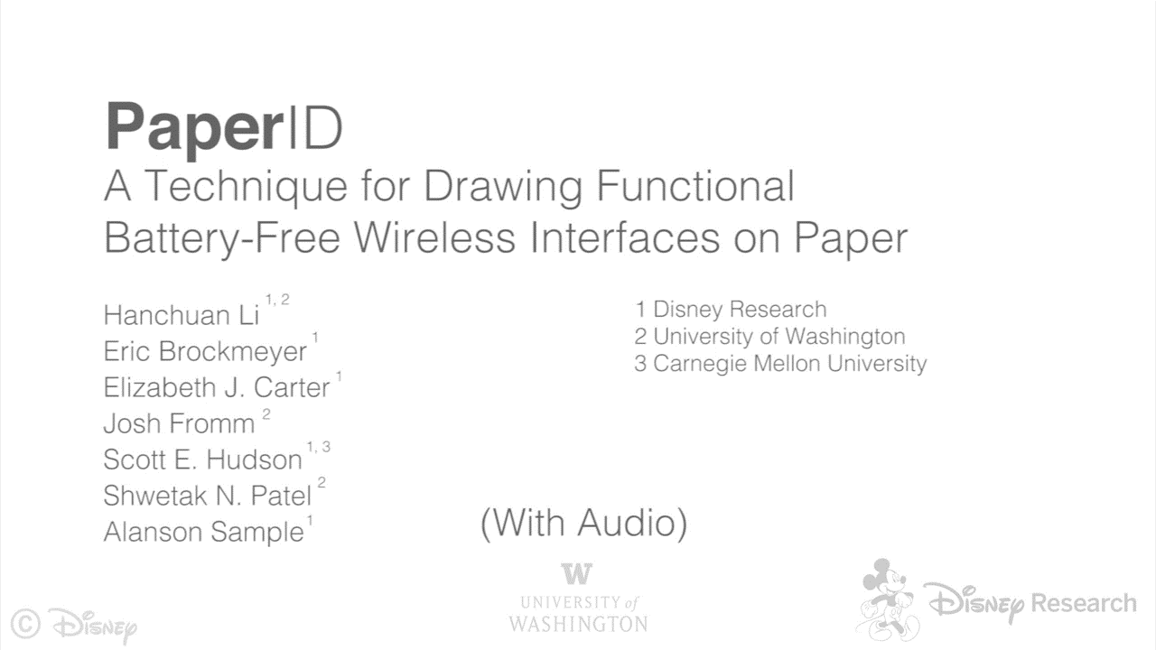
PaperID: A Technique for Drawing Functional Battery-Free Wireless Interfaces on Paper

Slide 9
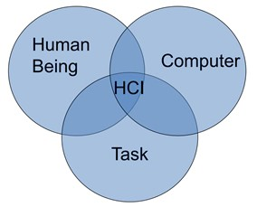
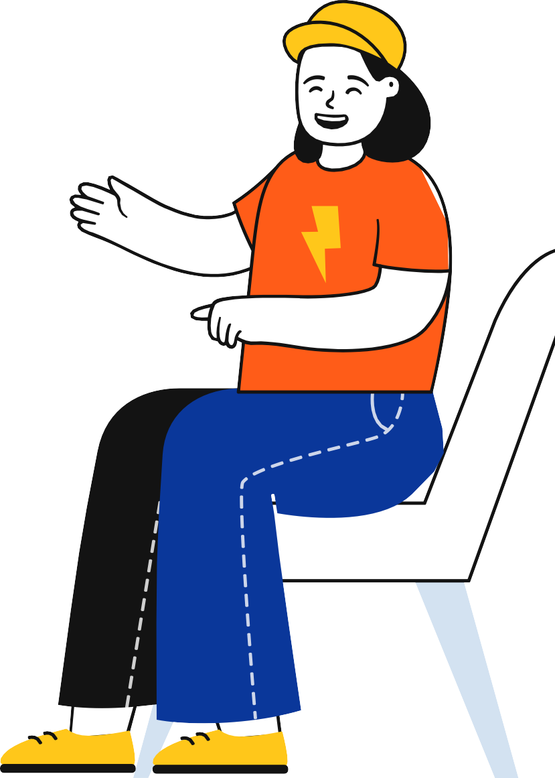

HCI consists of three parts:
Human: could be an individual user or a group of users.
Computer: could be any technology ranging from the general desktop computerto a large- scale computer system.
Interaction: any direct or indirect communication between a human and computer.

Slide 10
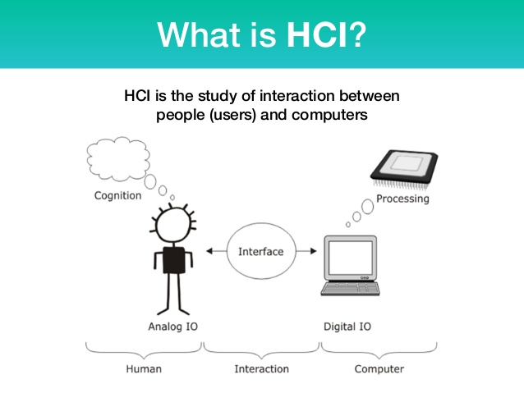
HUMAN-COMPUTER INTERACTION
THE HUMAN
input–output channels
Humans are limited in their capacity to process information. This has important implications for design.
Information is received, and responses given via a number of input and output channels:
- visual channel
- auditory channel
- haptic channel
- movement.
Information is stored in memory:
- sensory memory
- short-term (working) memory
- long-term memory.

Slide 11
HUMAN-COMPUTER INTERACTION
THE HUMAN
input–output channels
Humans are limited in their capacity to process information. This has important implications for design.
Information is processed and applied:
- reasoning
- problem solving
- skill acquisition
- error.
Emotion influences human capabilities.
Users share common capabilities but are individuals with differences, which should not be ignored.

Slide 12
HUMAN-COMPUTER INTERACTION
THE COMPUTER
A computer system comprises various elements, each of which affects the user of the system.
• Input devices for interactive use, allowing text entry, drawing and selection from the screen:
- text entry: traditional keyboard, phone text entry, speech and
- handwriting
- pointing: principally the mouse, but also touchpad, stylus and others
- 3D interaction devices.
• Output display devices for interactive use:
- different types of screen mostly using some form of bitmap display
- large displays and situated displays for shared and public use
- digital paper may be usable in the near future.

Slide 13
HUMAN-COMPUTER INTERACTION
THE COMPUTER
Virtual reality systems and 3D visualization which have special interaction and display devices.
Various devices in the physical world:
- physical controls and dedicated displays
- sound, smell and haptic feedback
- sensors for nearly everything including movement, temperature, bio-signs.
Paper output and input: the paperless office and the less-paper office:
- different types of printers and their characteristics, character styles
- and fonts
- scanners and optical character recognition.
Memory:
- short-term memory: RAM
- long-term memory: magnetic and optical disks
- capacity limitations related to document and video storage
- access methods as they limit or help the user.

Slide 14
HUMAN-COMPUTER INTERACTION
THE COMPUTER
Processing:
- the effects when systems run too slow or too fast, the myth of the infinitely fast machine
- limitations on processing speed networks and their impact on system performance.
THE INTERACTION
Interaction models help us to understand what is going on in the interaction between user and system. They address the translations between what the user wants and what the system does.
Ergonomics looks at the physical characteristics of the interaction and how these influences its effectiveness.
The dialog between user and system is influenced by the style of the interface.
The interaction takes place within a social and organizational context that affects both user and system.

Slide 15
HUMAN-COMPUTER INTERACTION
INTERACTIVE SYSTEM
Interactive system refers to any technological system which requires interaction with users. Interactive systems are computer systems characterized by significant amounts of interaction between humans and the computer.
Why HCI is a worthwhile field of study:
It provides a context in which to consider user-centered system design method.
HCI provides a basis upon which we can evaluate design methods for their efficiency and effectiveness.
HCI provides a real-world environment in which to develop new theories of user psychology.

Slide 16
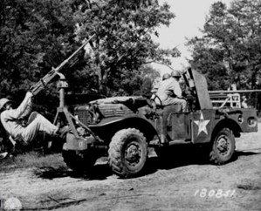

Brief History
Systematic study of human performance began during the last century in factories
The study of human factors started during the Second World War by US army.
Ergonomics Research Society
Established in 1949
Focused on physical characteristics of machines and systems and how these affects human performance.
Both disciplines are concerned with user performance in the context of a system
As computers became more common, more researchers specialized in interactions between computers and people
HCI became a popular term in the 1980s.

Slide 17
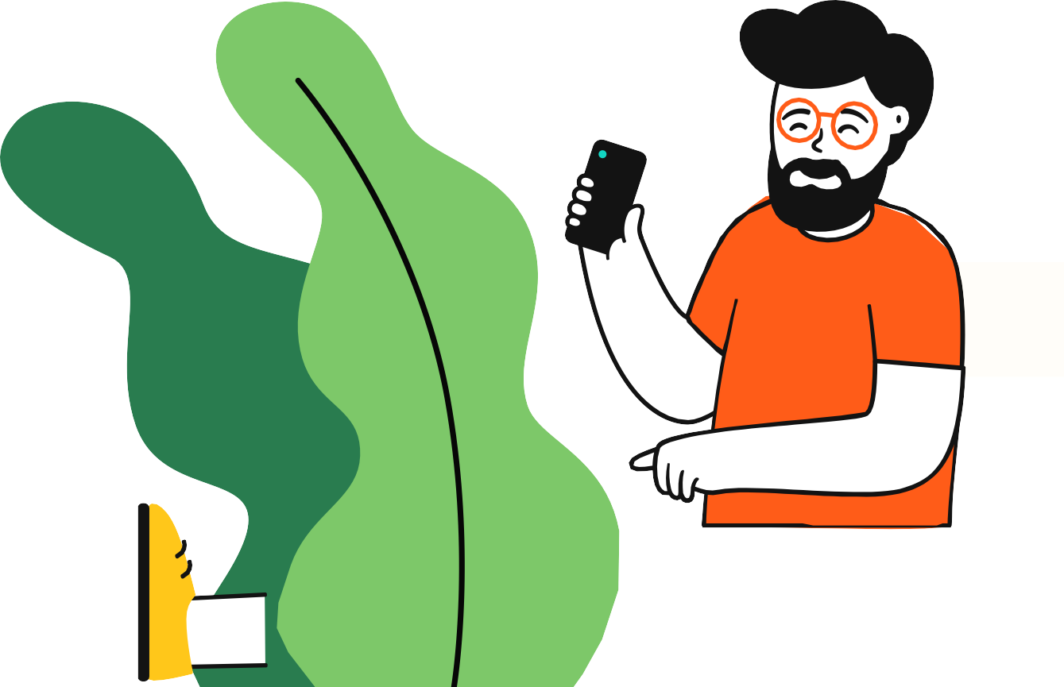

What is Usability?
Usability is a measure of how well a specific user in a specific context can use a product/design to achieve a defined goal effectively, efficiently, and satisfactorily. Designers usually measure a design’s usability throughout the development process from wireframes to the final deliverable to ensure maximum usability.

Slide 18
A usable system is:
easy to use
easy to learn
easy to remember how to use
effective to use
efficient to use
safe to use
enjoyable to use

Slide 19
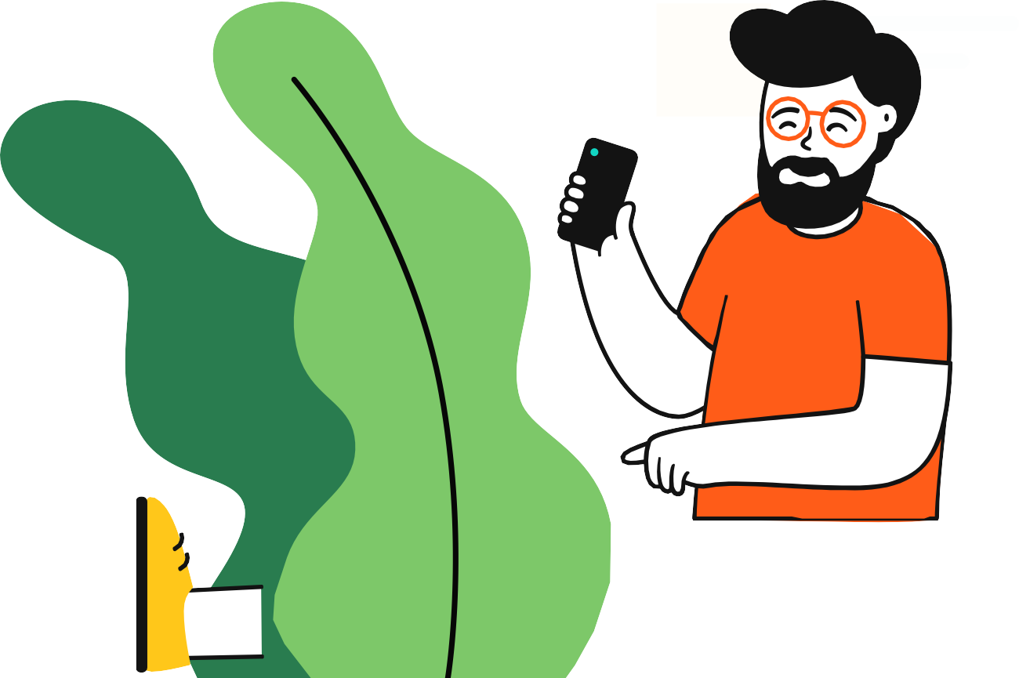
Why Usability is important?
A Good user-interface can: A Bad user-interface can:
1. Earn a company billions.
be annoying, embarrassing, frustrating, and even deadly.
Increase mistakes in data entry and system operation.
Makes functions become completely inaccessible.
System failure because of user rejection.
2. Increase users loyalty.
3. Increase users trust.
4. Makes users happy : )

Slide 20
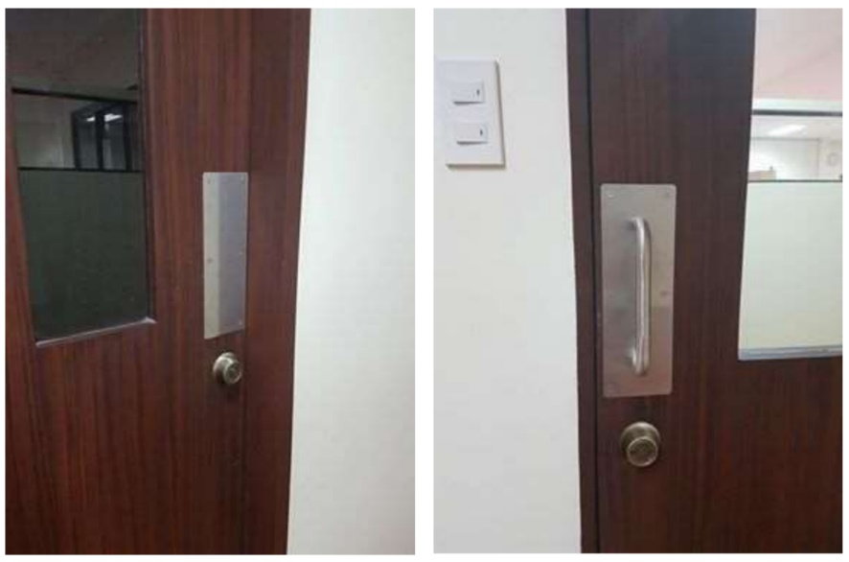
HCI DESIGN PRINCIPLES
Design Principles are generalizable abstractions for thinking about different aspects of design. It is the do’s and don’ts of interaction design. What to provide and what not to provide at the interface and derived from a mix of theory-based knowledge, experience and common sense.
Affordances
Refers to an attribute of an object that allows people to know how to use it.
• e.g. a mouse button invites pushing, a door handle affords pulling
Since has been much popularized in interaction design to discuss how to design interface objects
• e.g. scrollbars to afford moving up and down, icons to afford clicking on

Slide 21

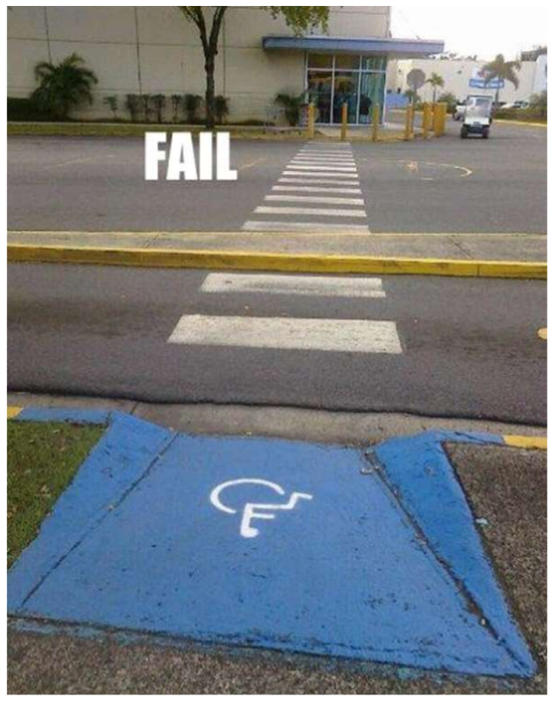
HCI DESIGN PRINCIPLES
Constraints
Restricting the possible actions that can be performed
Helps prevent user from selecting incorrect options
Physical, semantic, cultural, or logical
Physical Constraints
Constrain possible operations
Examples
- different keys fit different locks
- design of manhole covers - they are round so that they don’t fall into the hole
Semantic Constraints
Rely on the meaning of a situation to control actions
Cultural Constraints
Accepted cultural conventions that control actions
Logical Constraints
Relationship between spatial or functional layout of components and the things they affect

Slide 22
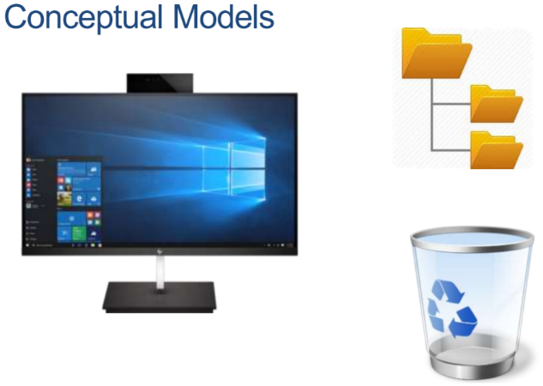
HCI DESIGN PRINCIPLES
Conceptual Models
• Mental models of a system
• Allow users to understand the system, predict effects, and interpret results
Consider this:
– Let’s say that your parents are in a bad mood
– The roof is leaking.
– Tuition fees are due.
– The dog just threw up on the floor.
– …
– Is this a good time to ask them for money?

Slide 23
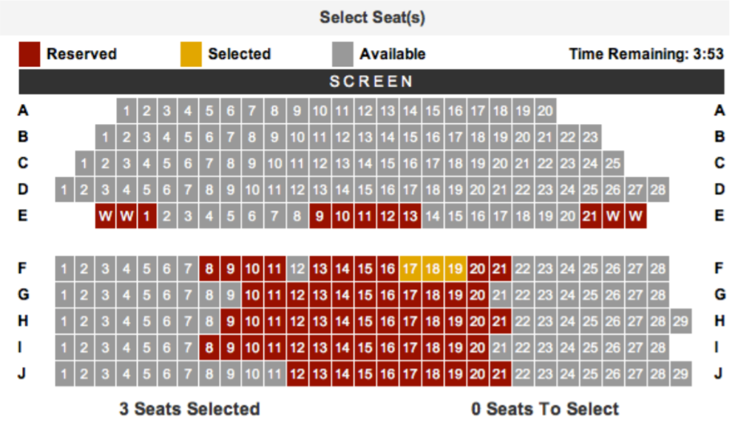
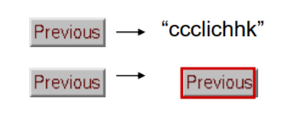
HCI DESIGN PRINCIPLES
Mappings
Relationships between controls and their effects on a system.
Visibility
• Design makes the conceptual model apparent to users
• Design tells the user what actions he can performs
• Getting trapped between glass doors
• Hinge was not obvious
• No handles, no panels
Feedback
• Sending information back to
• Includes sound, highlighting, animation and combinations of these e.g. when screen button clicked on provides sound or red highlight

Slide 24
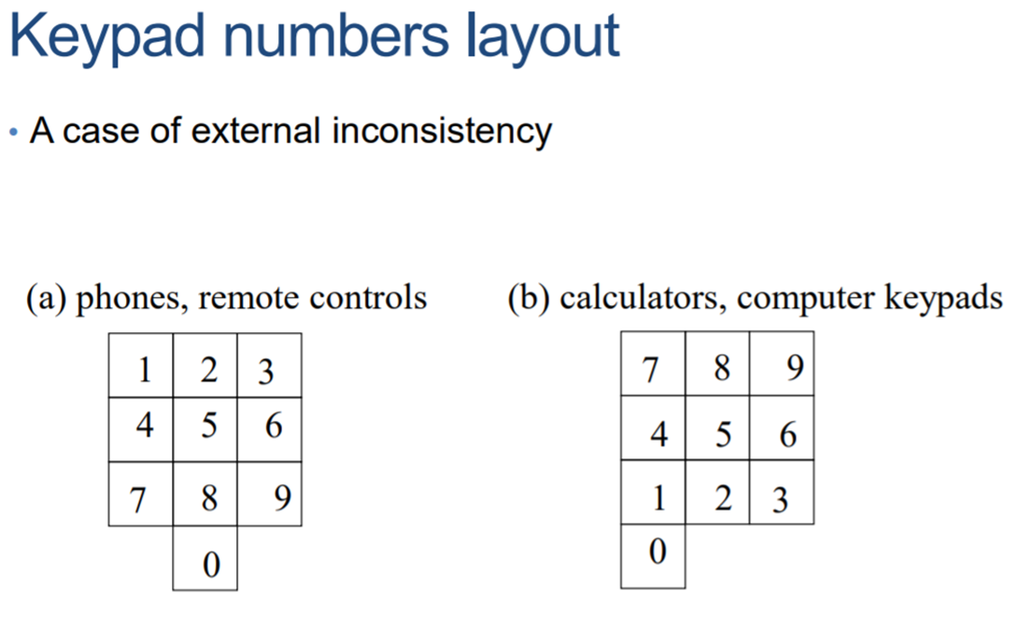
HCI DESIGN PRINCIPLES
Consistency
• Design interfaces to have similar operations and use similar elements for similar tasks
• For example:
always use ctrl key plus first initial of the command for an operation
ctrl+C, ctrl+S, ctrl+O
• Main benefit is consistent interfaces are easier to learn and use
Keypad number Layout is an example of external inconsistency
Design
• Design is about compromise
• It takes 5 or 6 tries to get a product right
• If a product fails within the first or second try, it’s dead
• Some products are guaranteed to fail, no matter how good the idea
• Designers are afraid to try

Slide 25
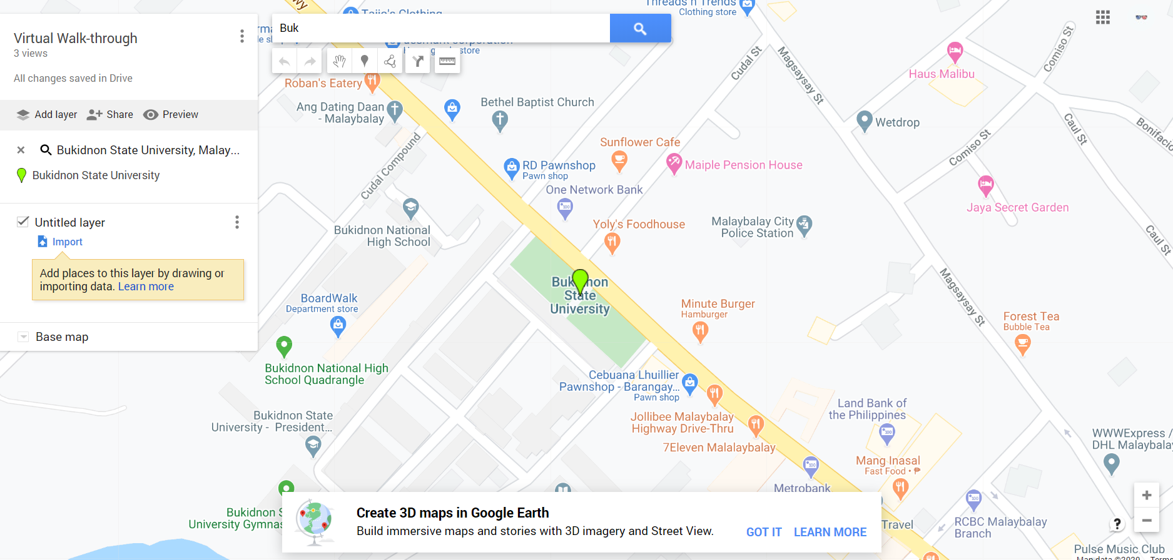

EXERCISE 1.1
Instruction: Using google maps, locate the route from your house to BukSU Main Campus. From the perspective of HCI, observe your user experience in terms of affordances, constraints, physical constraints, logical constraints, visibility and feedback.
Share your experience and post a screenshot with your explanation of your activity.

